Slide 1
travel to singapore
yifan yang

Slide 2



data
location data
venues data
hotel data

Slide 3
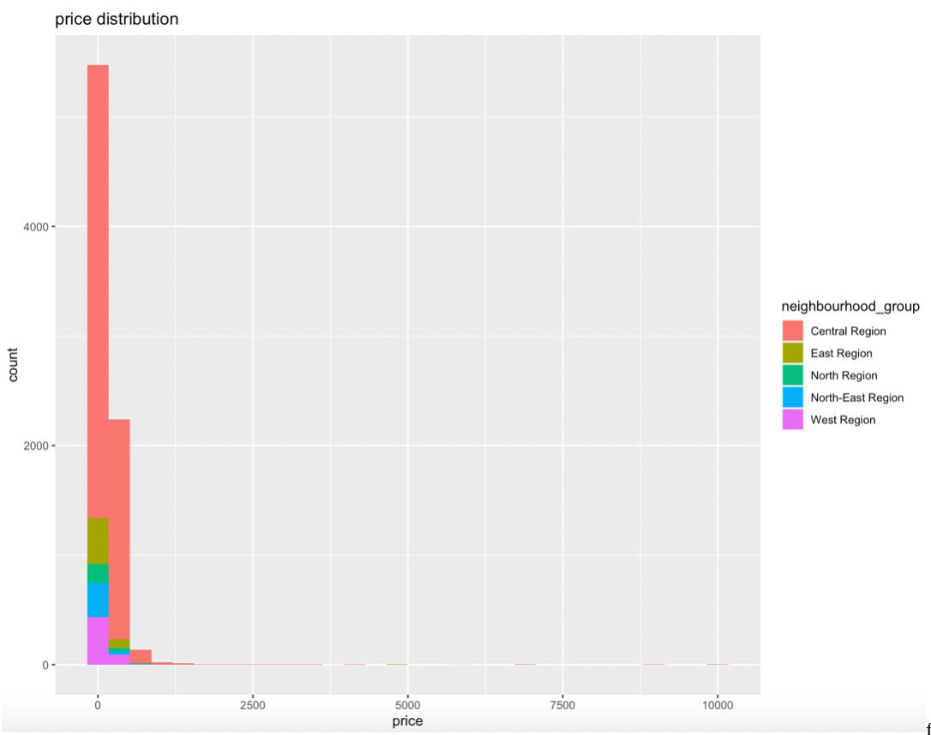
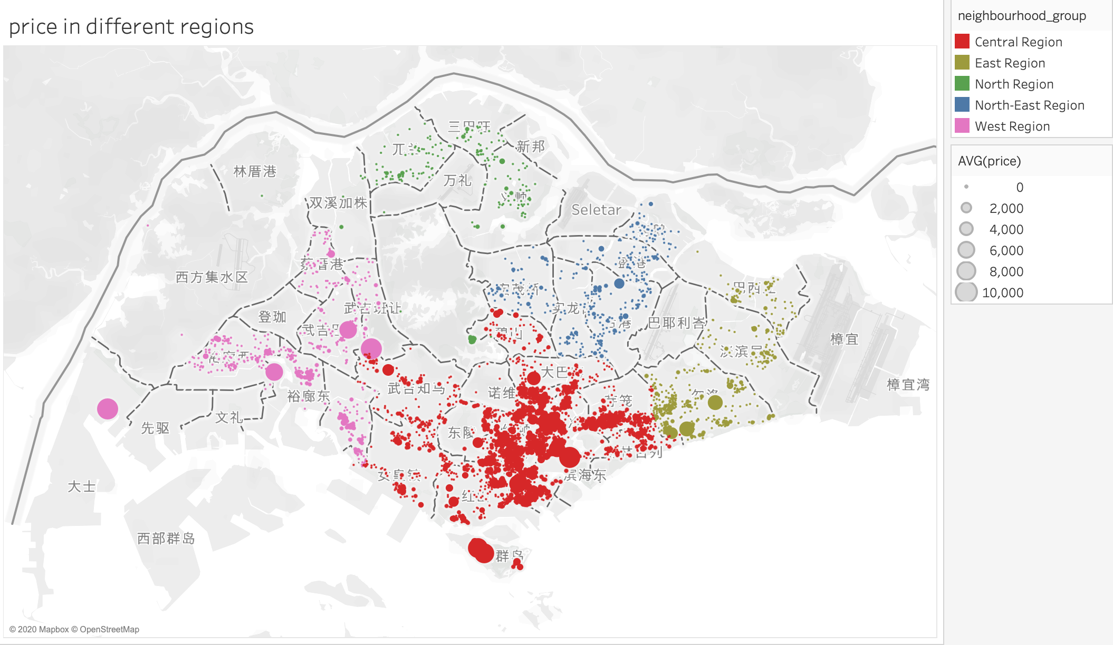
methodology

Slide 4
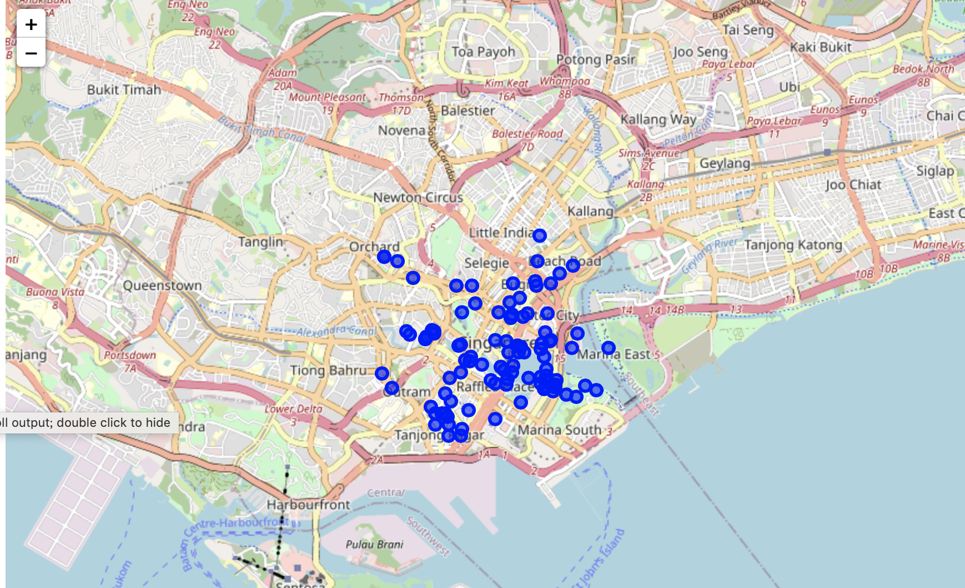
visualization

Slide 5
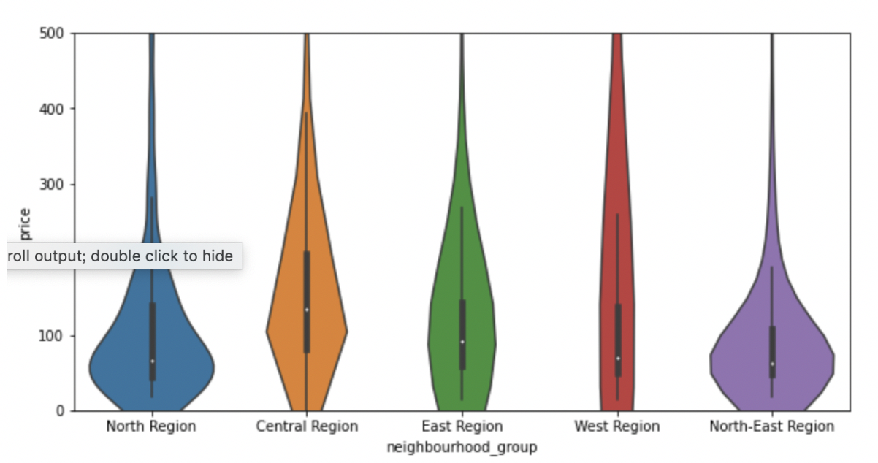

Slide 6
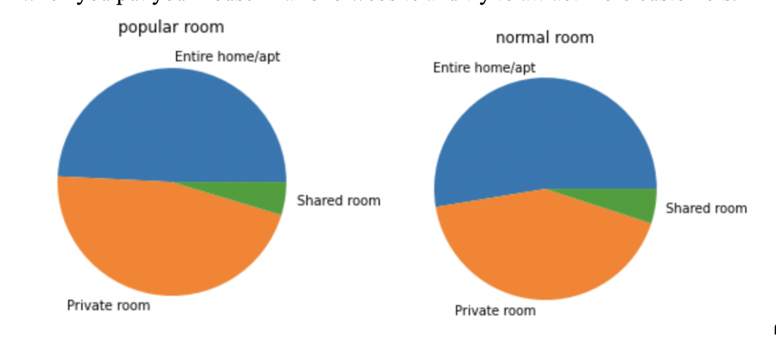
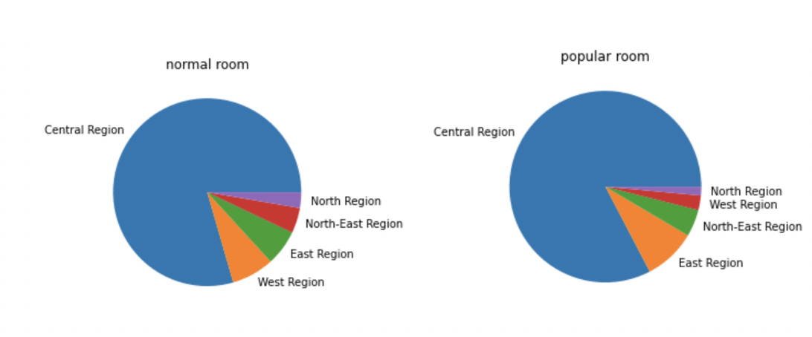
compare
top 10% as popular hotel
entire house/apt
central region

Slide 7
conclusion
geographical feature
venues categories
price

